Slide 1
Analyze churn rate telco

Slide 2
Abstract
In this presentation, we delve into a comprehensive analysis of the churn rate within a prominent telecommunications company. By examining key customer behaviors, trends, and satisfaction metrics, we unveil actionable insights aimed at mitigating churn and enhancing customer retention strategies, thereby fostering sustainable business growth.

Slide 3
Objective
Does the count of unique customers match the count of customer? Indicate also the number of unique customers
What's the total churn rate for "Databel"?
Which of the following is part of the top 3 churn reasons?
What's the most prevalent churn category?
Which state has the highest churn rate?
Did you discover that the churn rate for senior citizens is significantly above the average? What's the churn rate for that group?

Slide 4
Which group size has the lowest churn rate?
What is the churn rate for female customers in monthly-based contracts?
What's the churn rate for people on an unlimited plan who consume less than 5 GB of data?
Exploring the different payment methods, you will see that there is one type that is much smaller than the others. What is the total number of customers for this Payment Method?

Slide 5
What's the churn rate (in %) for customers who are not in a group plan, that belong to the age group 50, and who have an account length of 12 months or less?
What's the average number of customer service calls for customers who are on a monthly contract and pay by direct debit? What is the churn rate for those customers?
What are the average extra data charges (two decimal points) for customers who are not on an unlimited data plan and consumed 10 or more gigabyte?
Which state has the highest churn rate and yet the lowest sum of customer service calls? And what is the number of total customer service calls for that state?

Slide 6

Does the count of unique customers match the count of customer? Indicate also the number of unique customers What's the total churn rate for "Databel"?
There is a 6687 of Total Customer, 1796 Customer of churn and have a 26.86% Customer of Churn Rate

Slide 7
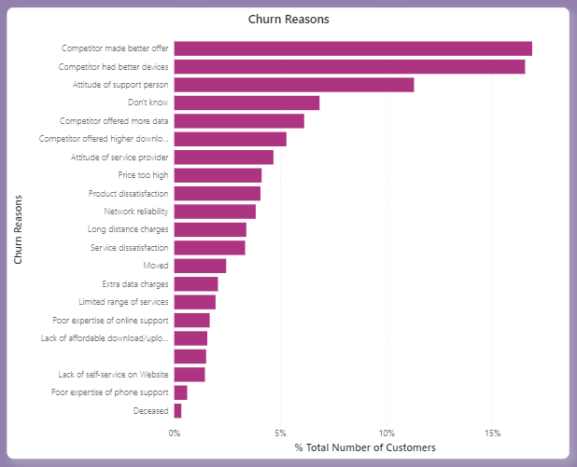
Which of the following is part of the top 3 churn reasons?
Customers have reasons to churn, the top 3 of which are
Competitor made better offer
Competitor had better devices
Attitude of support person

Slide 8
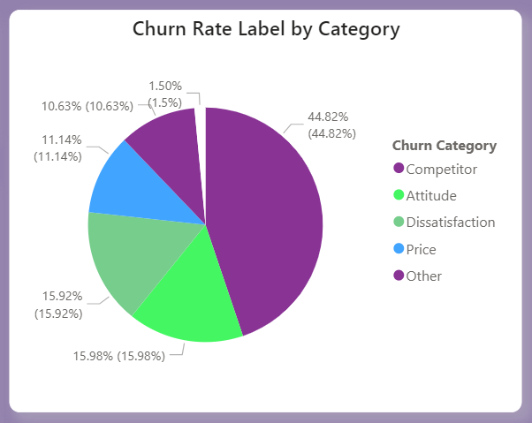
What's the most prevalent churn category?
The most prevalent churn rate by category is Competitor, 44.92% from total Churn Rate by category

Slide 9

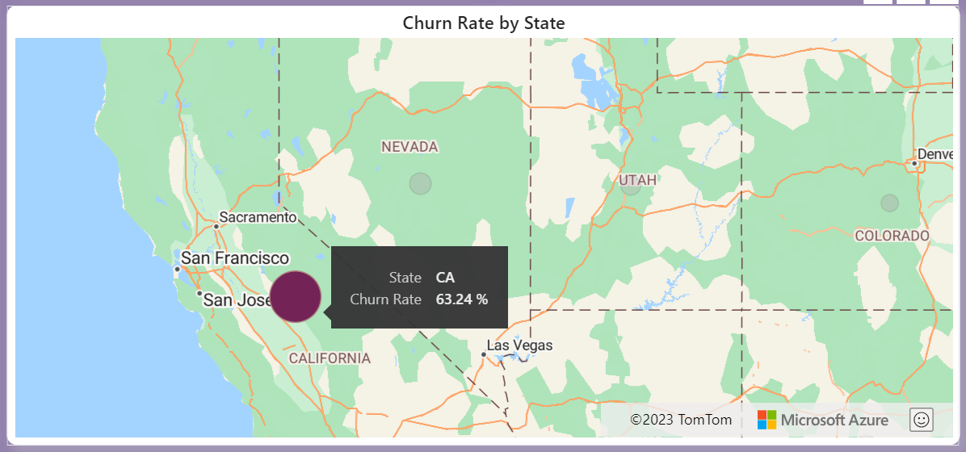
Which state has the highest churn rate?
The state has the highest churn rate is a State have code CA, have a 68 total of customer, 43 total of churned and 63.24% total of churn rate,

Slide 10
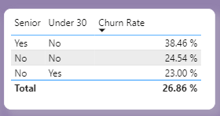
Did you discover that the churn rate for senior citizens is significantly above the average? What's the churn rate for that group?
We found 38.46% for churn rate senior citizens

Slide 11
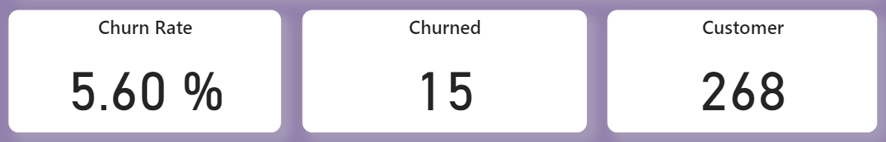
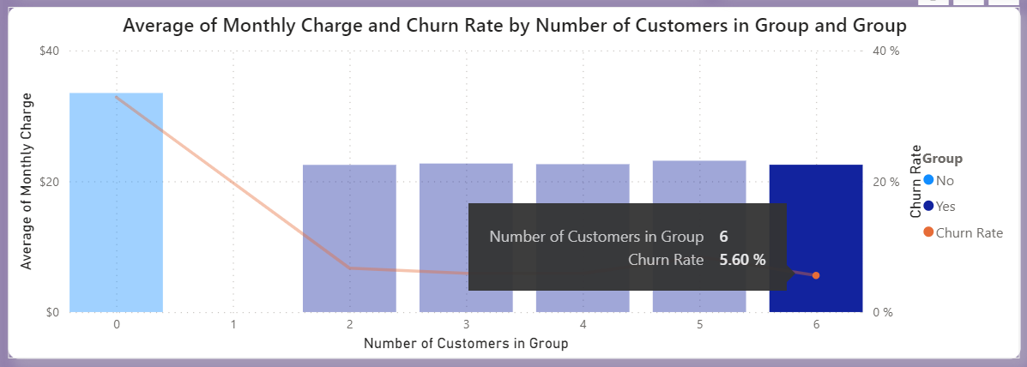
Which group size has the lowest churn rate?
In group 6 has a 268 total of customer, 15 total of churn, and 5.60% total of churn rate

Slide 12
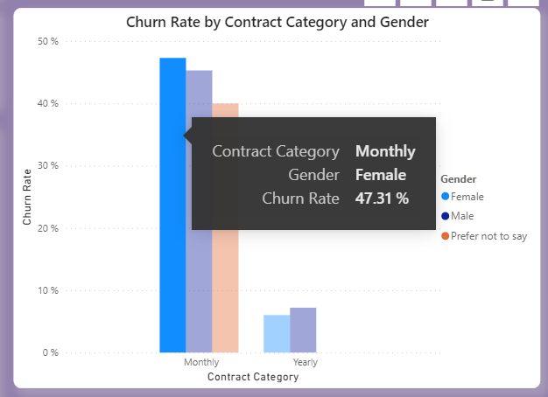
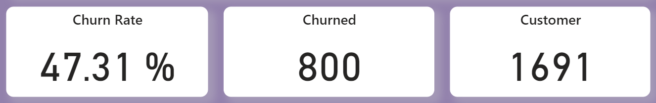
What is the churn rate for female customers in monthly-based contracts?
Total of churn rate in female customer is 47.31%, and total 800 customer of churn from 1691 of total customer

Slide 13
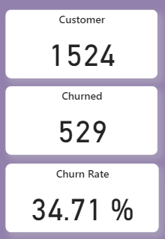
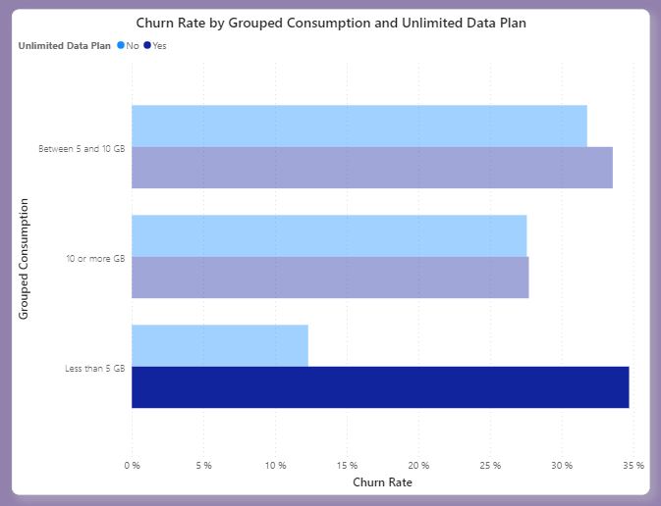
What's the churn rate for people on an unlimited plan who consume less than 5 GB of data?
The total of number in the group consumen who using unlimited data less than 5 GB of data is 1524, total of churn is 529 and total of churn rate is 34.71%

Slide 14
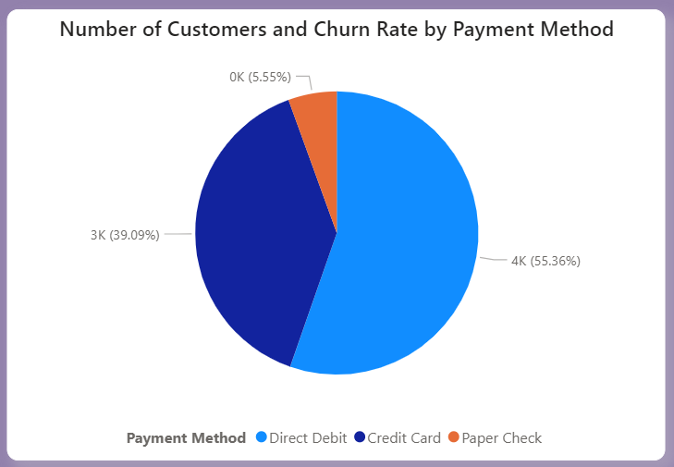
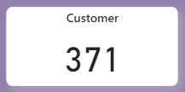
Exploring the different payment methods, you will see that there is one type that is much smaller than the others. What is the total number of customers for this Payment Method?
371 Number Of Customers is much smaller than the others

Slide 15
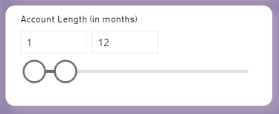
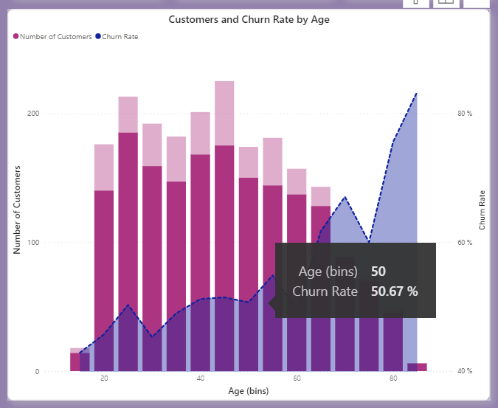
What's the churn rate (in %) for customers who are not in a group plan, that belong to the age group 50, and who have an account length of 12 months or less?
50.67% churn rate for customer who are not in group plan, and the age group in 50, and less or 12 month in length account

Slide 16
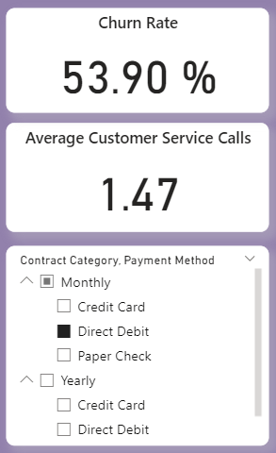
What's the average number of customer service calls for customers who are on a monthly contract and pay by direct debit? What is the churn rate for those customers?
Average number of customer calls who are on a monthly contract and pay by direct debit is 1.47 and have a churn rate is 53.90%

Slide 17
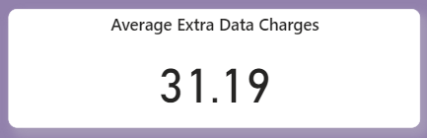
What are the average extra data charges (two decimal points) for customers who are not on an unlimited data plan and consumed 10 or more gigabyte?
Average extra data charges for customer who are not on a unlimited data plan and consumed 10 more gigabyte is 31.19

Slide 18
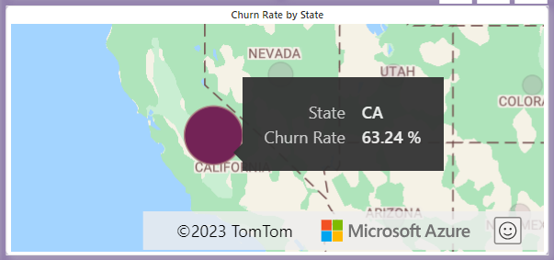

Which state has the highest churn rate and yet the lowest sum of customer service calls? And what is the number of total customer service calls for that state?
State has the highest churn rate is a state with code CA and total of customer service call for that state is 44

Slide 19
Conclusion
The state with the highest churn rate is the country with the CA code
Customers have reasons to churn, the top 3 of which are
Competitor made better offer
Competitor had better devices
Attitude of support person
The gender with the most churn rate is female
The age with the most churn rate over 60 years old
The use of direct debit which has the highest churn rate
Recommendation:
Give a most of service for customer in gender female
Upgrade attitude and service of support person
Give a benefit for customer with category payment direct debit

